Slide 1

This the home page when I click on joinnow go to page contact

Slide 2
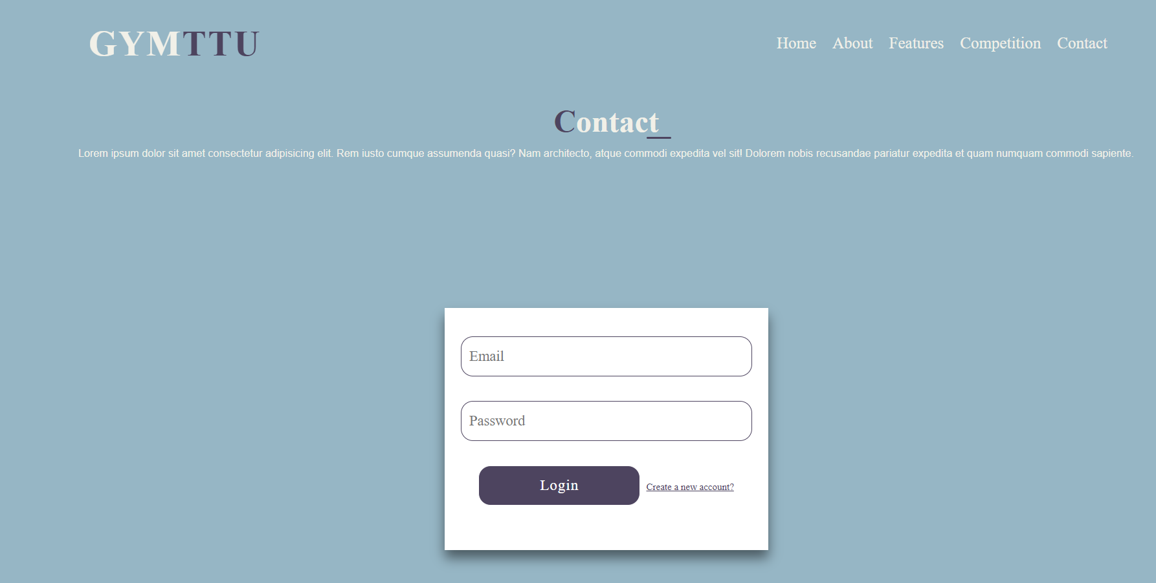
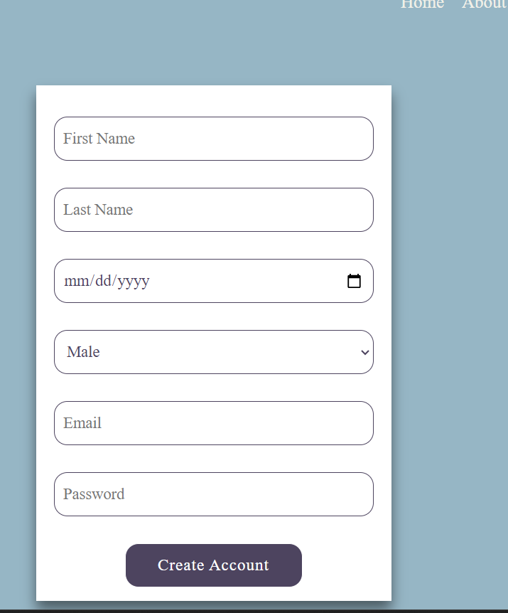
When I click on login go to page present your reservations, Competition,BMI
When I click on create a new account (dynamic loading)

Slide 3
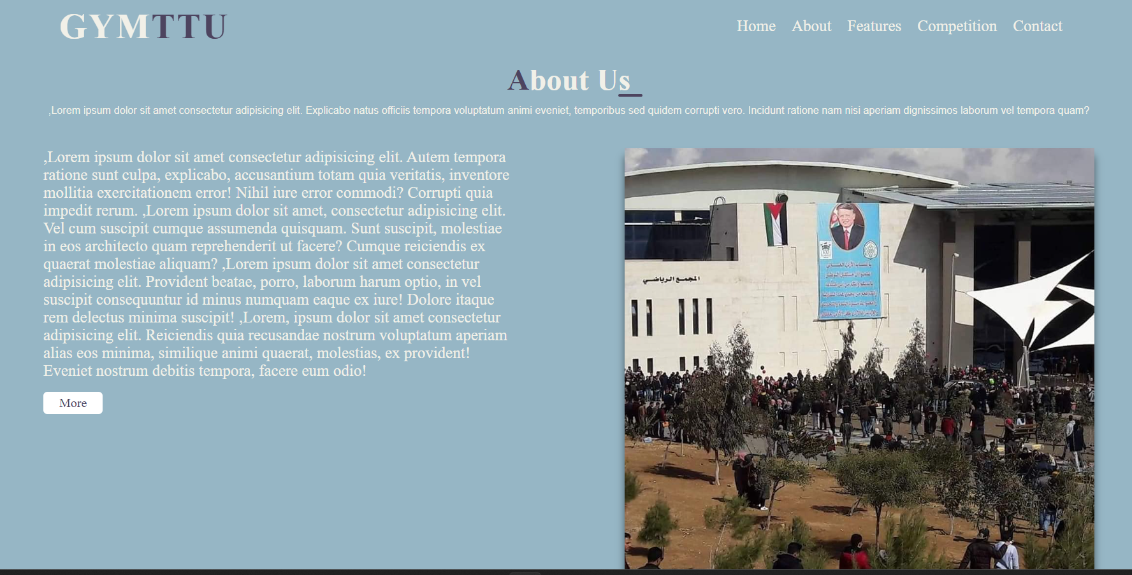
حفظ الترجمة
A brief introduction to the place

Slide 4
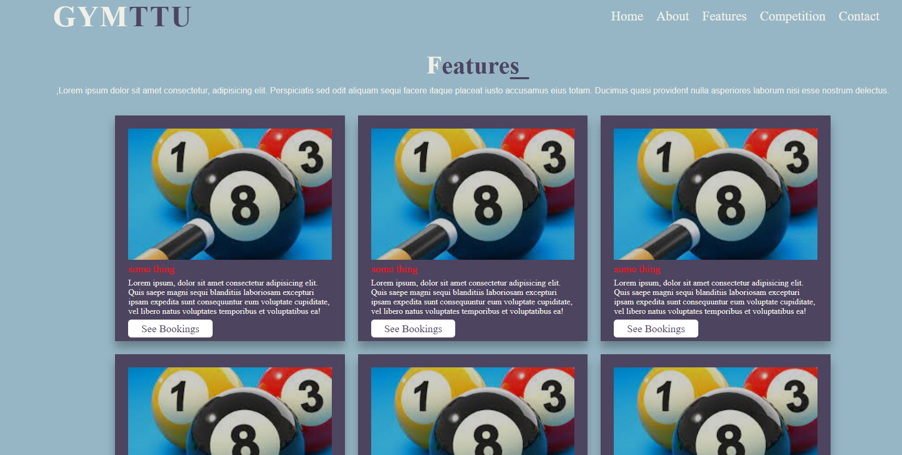
Implementing a booking system with available and reserved time slots for activities in your gym involves integrating a backend system to handle the data and interactions. (paython and sql)
Click on see bookings

Slide 5
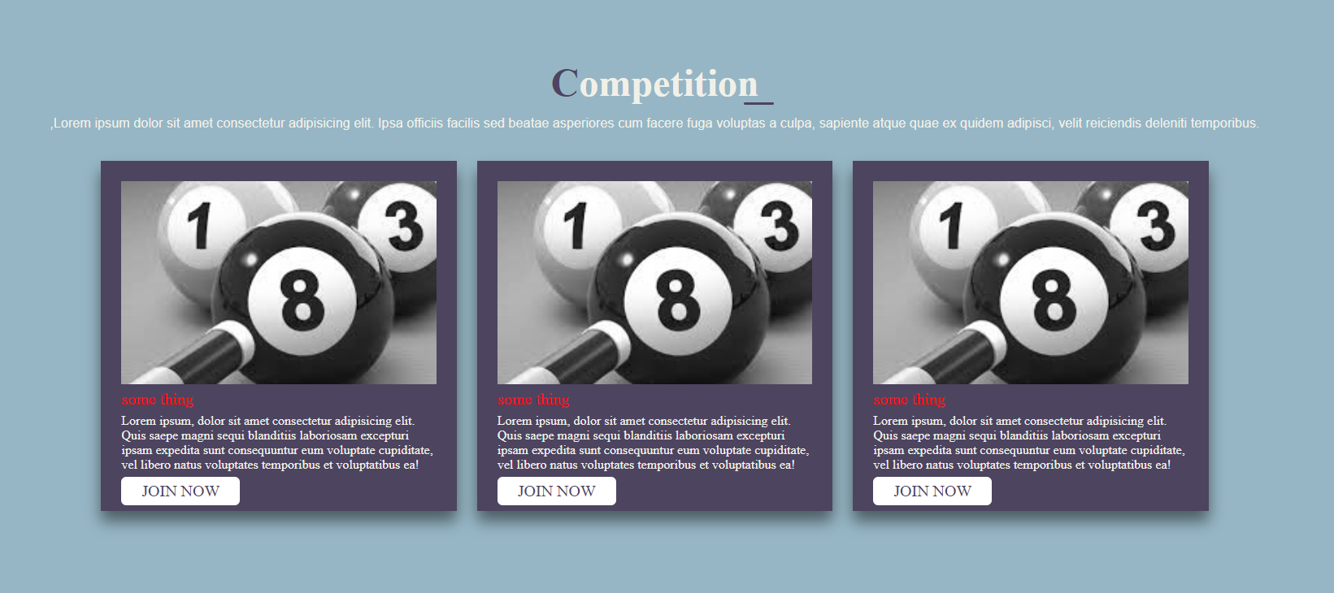
Also in this I will use backing system

Slide 6
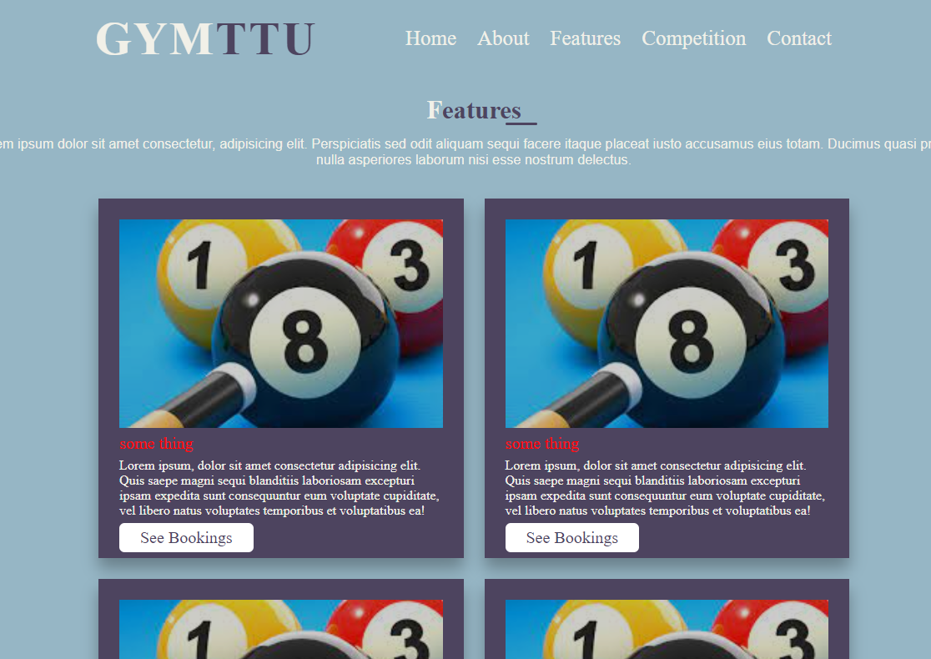
My website is responsive

Slide 7
